Slide 1


Predicting Market Value -
English Premier League Players

Slide 2

Market Value
Objective
Important for Clubs to successfully manage transfer market
Market value of a soccer player is crucial → Potential Transfer Cost, Salary($$$)
Determined by several components(age, # of goals, # of passes...etc)
Predict market value of players in current English Premier League season based on cumulative stats recorded from 1992 ~ 2021.

Slide 3
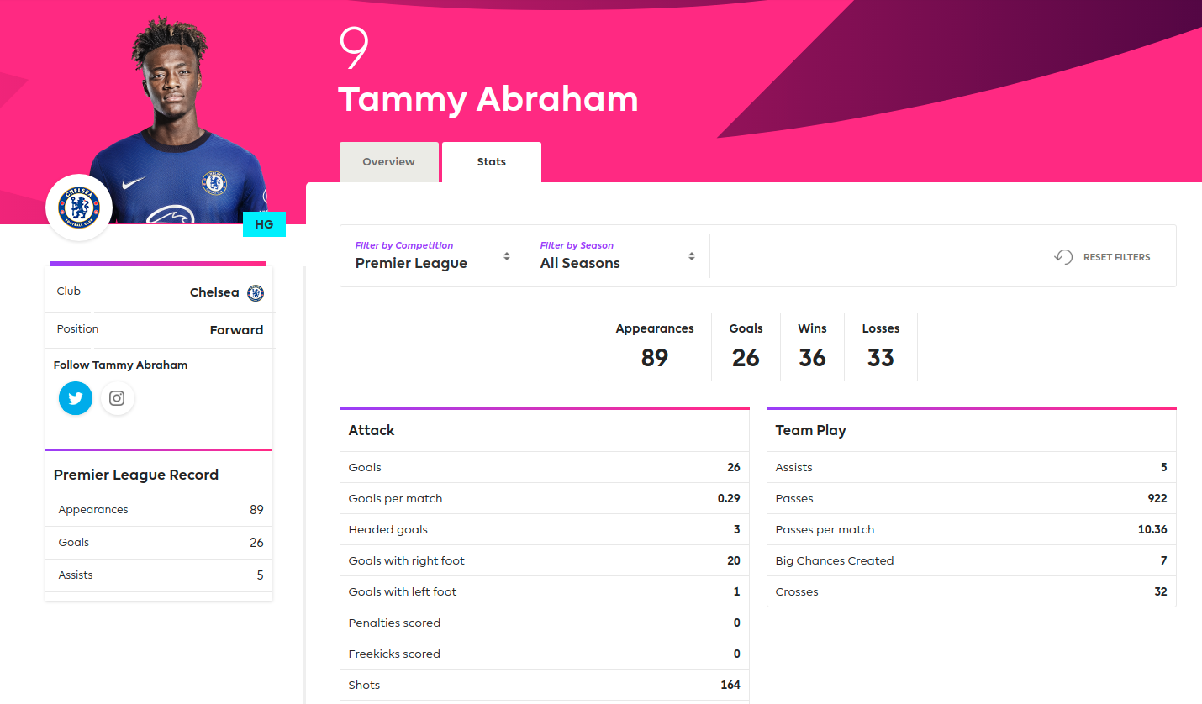
Features Included
Appearance
Position(Forward, Midfielder, Defender, Goalkeeper) - categorical variable
Goals
Assists
Passes
Passes per match
Fouls
Yellow cards
Red cards

Slide 4
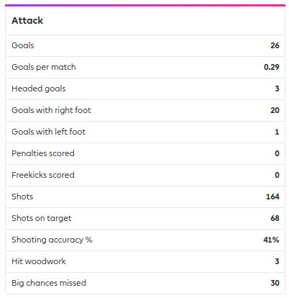

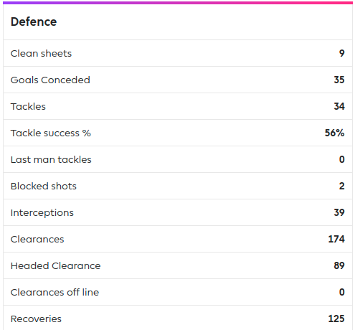
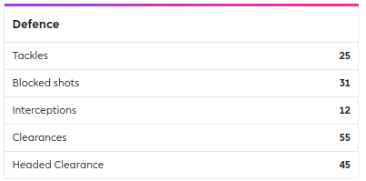
Player A
Player B

Slide 5
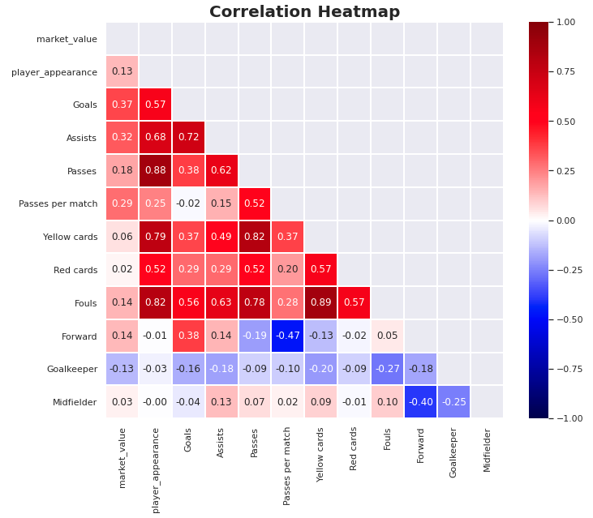
EDA to select/remove certain features

Slide 6
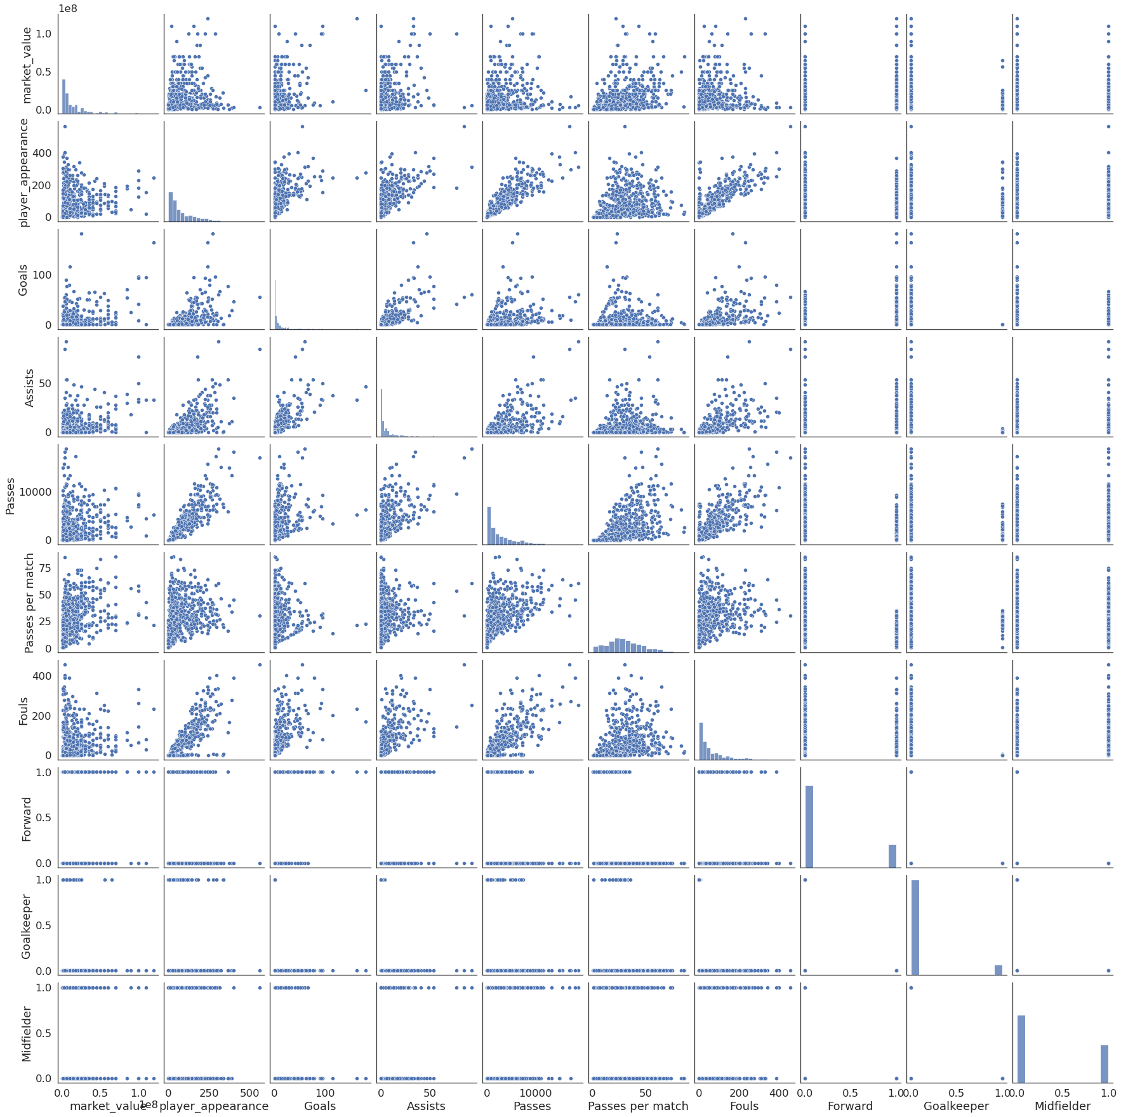
EDA Pair Plot Analysis
Market value highly skewed
Distribution of Market Value shows slight hint of exponential

Slide 7
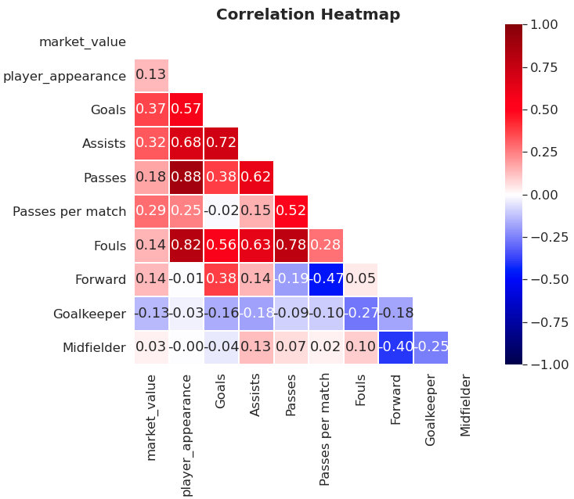
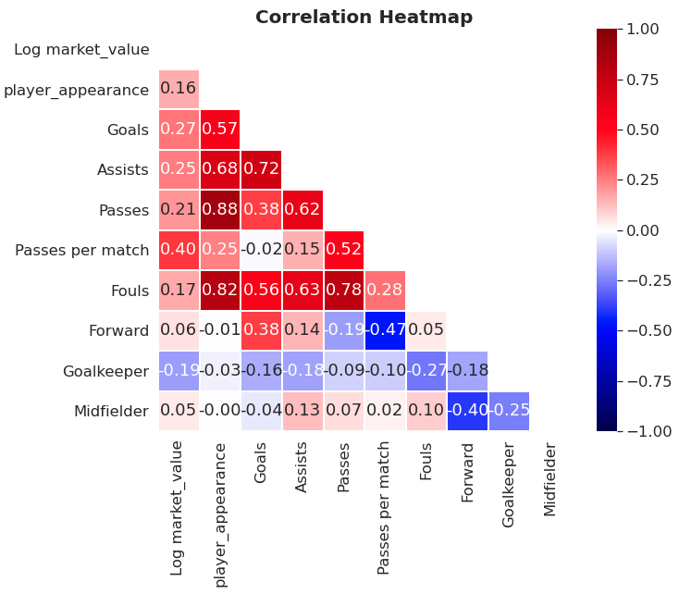

Slide 8
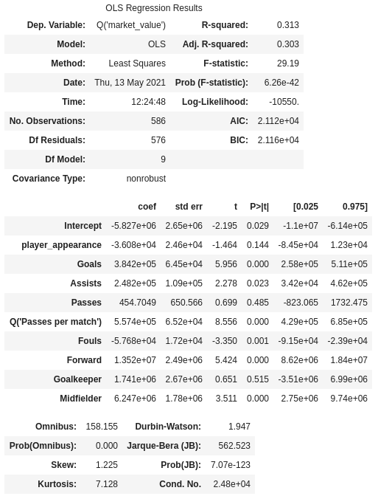
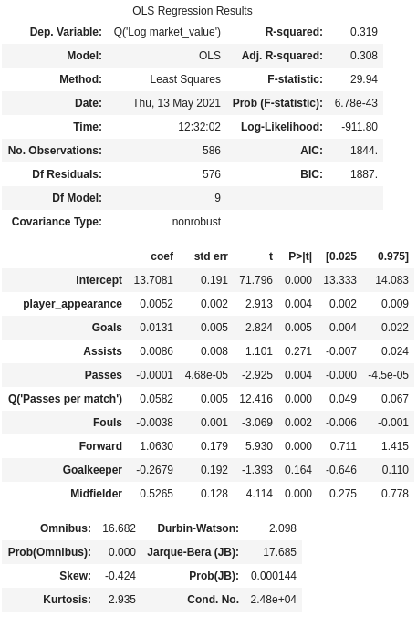

Slide 9
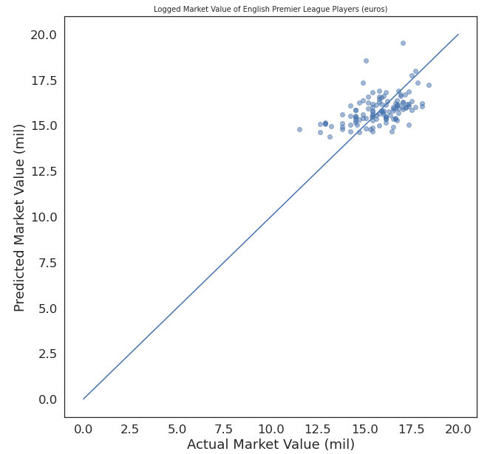
Regression Modeling
Linear Regression
Ridge Regression
Lasso Regression
Cross Validation Test on Training Data | R-Squared Value
Linear Regression | 0.293709
Ridge Regression | 0.293776
Lasso Regression | 0.239135
Result of Test set through chosen model : Ridge
R-Squared Value | 0.234976
MAE | 0.929720

Slide 10
Future Work/Improvements
Consider data collection from other source
Look closely into polynomial regression
Increase dataset

